Slide 1
Escalation Process
Mobil Lubricant Analysis (MLA)

Slide 2
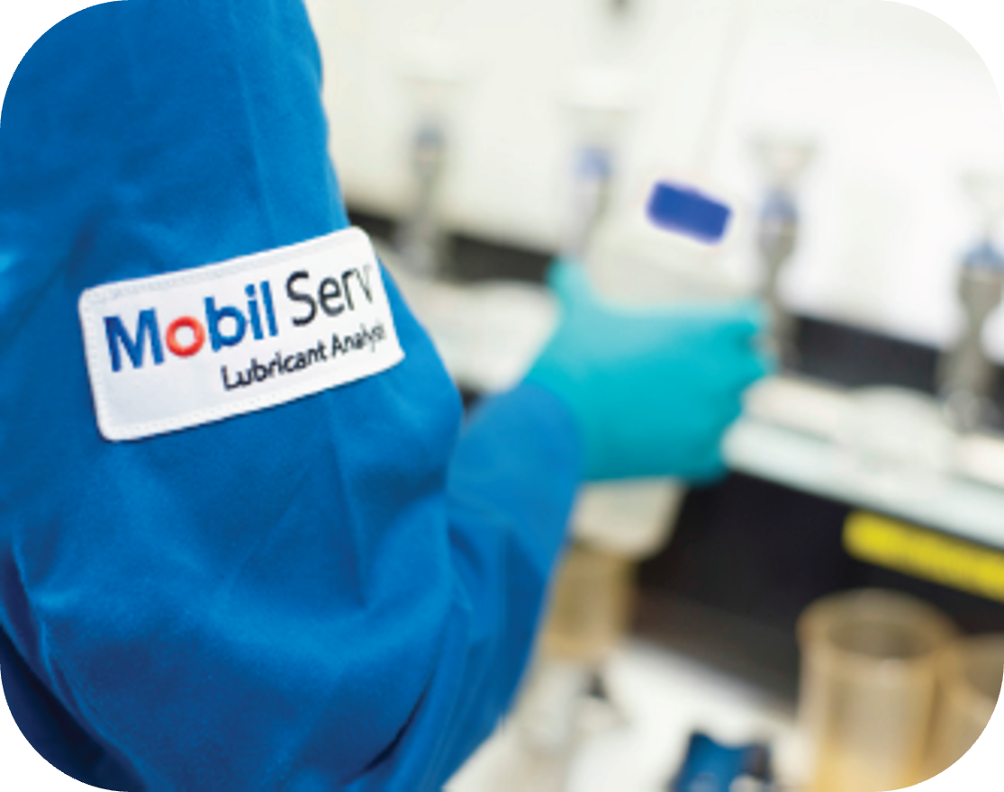
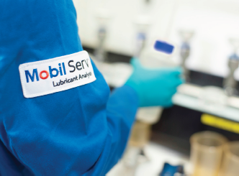
Table of Contents
• Troubleshooting before escalating to BSA
• Where to find Help in MSLA: User Guides
• Creating A Helpdesk Ticket
• Submitting a Help Desk Ticket
• Example Ticket
• Escalating/Contacting the Lab

Slide 3
Troubleshooting before escalating to BSA
All tickets should be triaged before reaching out to BSA for further assistance.
Utilize MLA Help tile (Helpfiles) to troubleshoot issue
Attempt to reproduce
  If unable to reproduce, reach out to client for more details such as what browser is being used, other items, or setup troubleshooting session with the client.
  Example: If user needs to have a password reset, try triggering this from the ‘User details’ page
3. Is the user properly assigned to the asset / account / security roles / etc?
4. Attempt to diagnose as much as possible through MLA user interface.
5. Confirm if other users reported the issue.

Slide 4
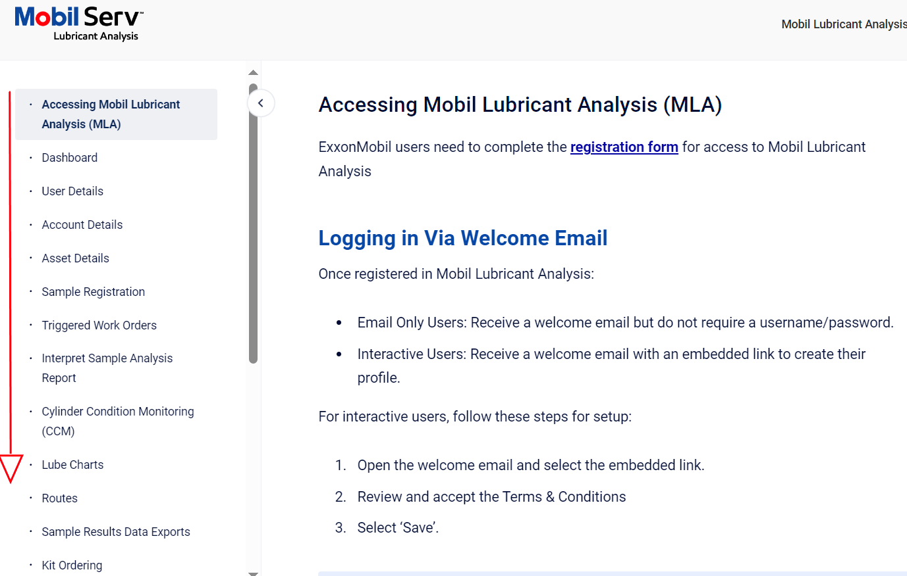

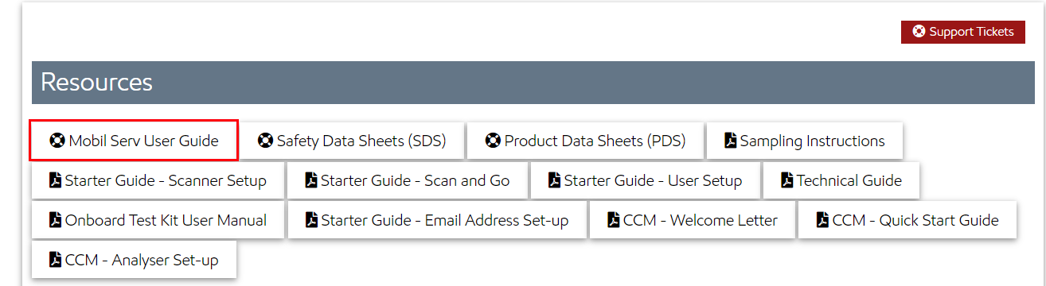
Where to find Help in MLA User Guides
Click on the Life Preserver
Select ‘Mobil User Guide’
Use Search Bar or the Left panel

Slide 5
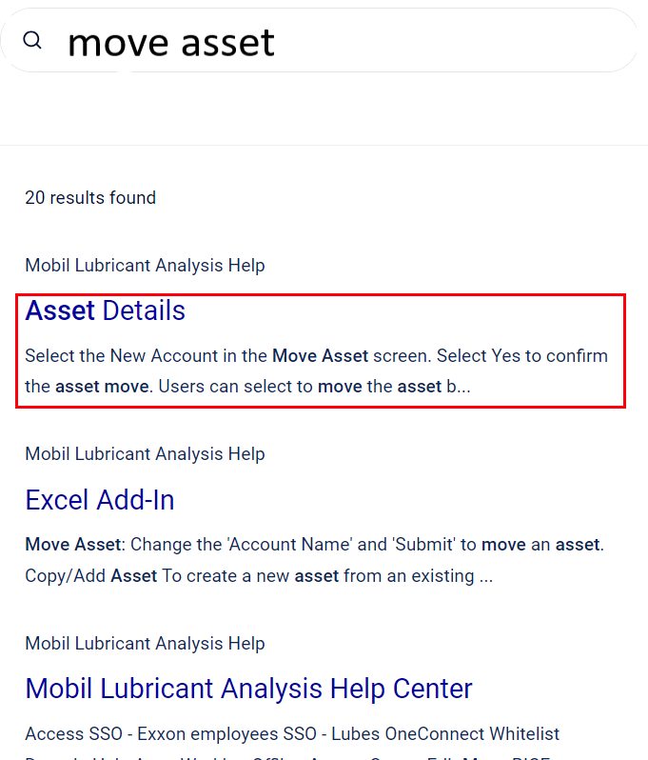
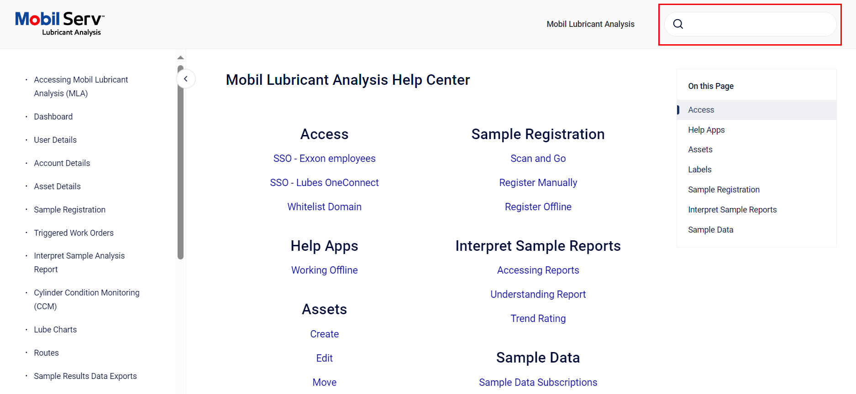
Where to find Help in MLA User Guides
Search for a Subject
Use Search Bar or the Left panel
Choose the best article
Help Files

Slide 6
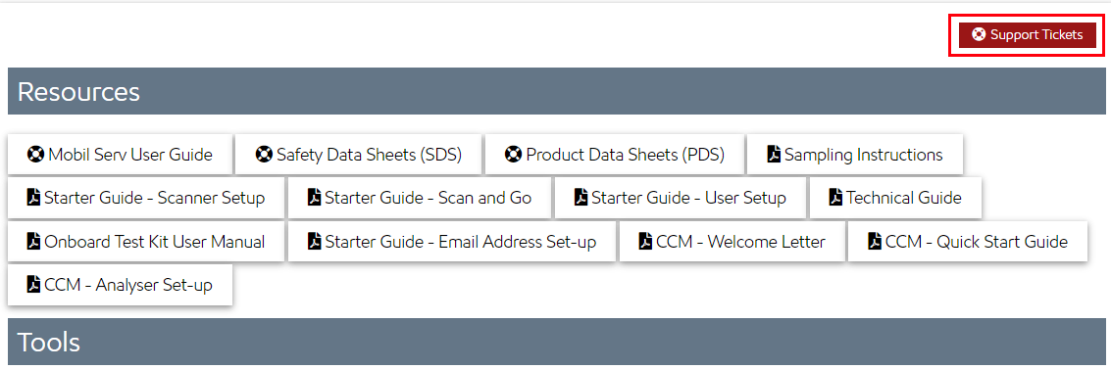
Creating A Helpdesk Ticket
For advanced issues where BSA or developer assistance is needed, a helpdesk ticket can be submitted.
This can be done via the Life Preserver icon
Select Support Ticket to open tickets

Slide 7
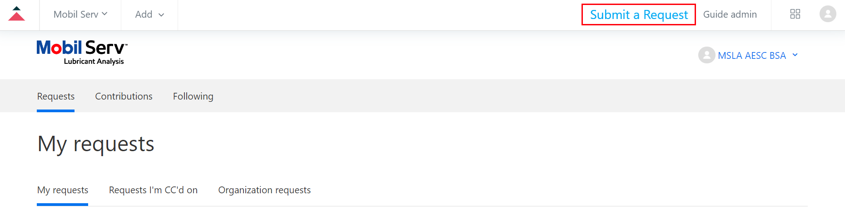
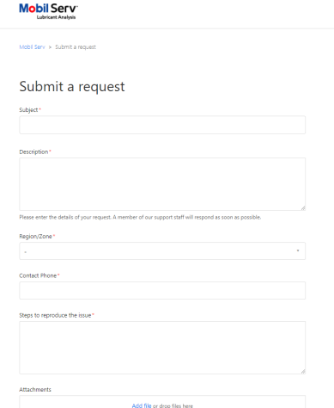
Submitting a Help Desk Ticket
When submitting a helpdesk ticket, please provide as much detail as possible.
Examples of information the BSA and developers need:
• Affected user email(s) and/or user account(s)
• Screenshots of the issue
• Steps to reproduce the issue
• Expected Result
• Actual Result
• Which browser? (Google Chrome or MS Edge preferred)
• Any troubleshooting completed so far
More details can be found in the helpfiles.

Slide 8
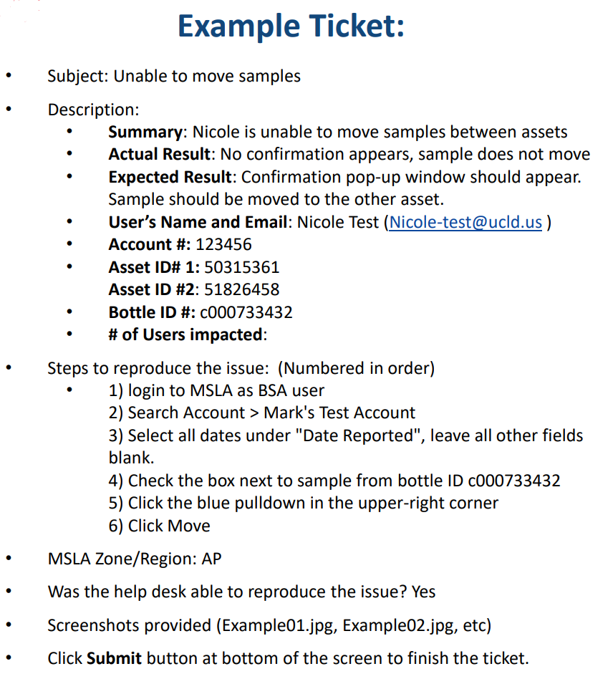
Example Ticket
After troubleshooting, escalate to BSA via the ticketing system.
Please provide the details so they have adequate details to handle the request.

Slide 9
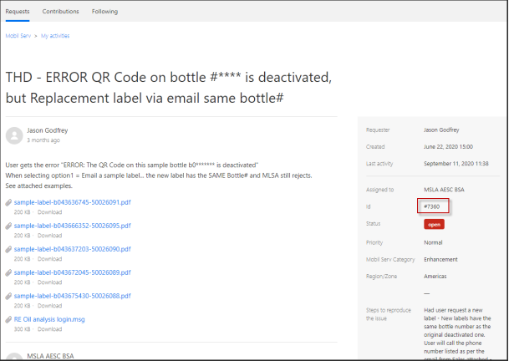
Communicating Vis the Help Desk
The Utility Cloud support team (BSA) monitors the ticket system. You will be notified that it was received via email. BSA will reach out with any updates. EM Helpdesk can respond to the email which updates the Ticket.
• You can see the status of each ticket and see if BSA is “waiting your reply”, open or closed.
• Tickets can be used for both Customer issues and requesting enhancements.
• EM Helpdesk can also add a comment directly to the ticket in this interface.
• Once the issue is confirmed to be resolved, update the ticket asking BSA to close.

Slide 10
Escalating/Contacting the Lab
Customer has questions about Testing methods, results and Limits used – contact the Lab.
• Adding a product to the drop-down
• Adding a manufacturer or model to the drop-down
• Questions about limits and interpretation
• Sample Delays (provide bottle number)
• Registered (Pending) Status, but I have not received my Results ?
Contacting the lab: These email addresses are for Internal Use Only, do not give to the customer.
• Americas - KC Mobil Serv Lab /SM = kc.mobil.serv.lab@exxonmobil.com
• Asia Pacific - Shanghai Lab - apfdslubeline@exxonmobil.com
Problem Samples: If a sample is received with no asset or not enough information, the lab logs it as a problem sample and asks EM Help Desk to contact sales or customer. Problem Samples are only held for 30 days before being disposed of. If after 30 days, the customer will need to submit a new sample.

Slide 11



